Slide 1

Data Analysis Essentials
Cornerstone Project — Second Review
Library Management System
Presented by
[B.V.V.SATYANARAYANA-26B21AI014]
[G.D.ESWAR SHANMUKH – 26B21AI034]
[G.SAI CHARAN – 26B21AI043]
[S.T.N.V.GANESH – 26B21AI071]
Department
Department of Artificial Intelligence & Machine Learning

Slide 2
SECOND REVIEW
This project emphasizes completed coding work, output, visualizations and meaningful findings.
1. Implementation
2. Data Inspection
Google Colab notebook executes successfully and creates the CSV dataset.
Shape, columns, data types and missing values are checked using Pandas.
3. Analysis
4. Visualization
NumPy and Pandas statistics identify borrowing, category and fine patterns.
Histogram, bar chart, scatter plot and pie chart are generated.
5. Results
Key findings and a simple availability-based recommendation are presented.
2

Slide 3
PROJECT OVERVIEW — LIBRARY BOOK ANALYSIS
The project analyzes a small library dataset to understand borrowing demand, book availability and fine amounts.
Problem
Objective
Domain
Library staff need a simple way to inspect book usage, availability and overdue-fine patterns.
Create a CSV dataset, perform statistical analysis, visualize patterns and recommend popular available books.
Library Management / Educational Data Analysis.
Dataset
Tools
10 book records and 8 columns: Book_ID, title, category, borrow count, copies, fine and status.
Python • Google Colab • Pandas • NumPy • Matplotlib • CSV
Core decision rule
Recommend a book when Borrow_Count ≥ user-defined minimum AND Available_Copies > 0.
3

Slide 4
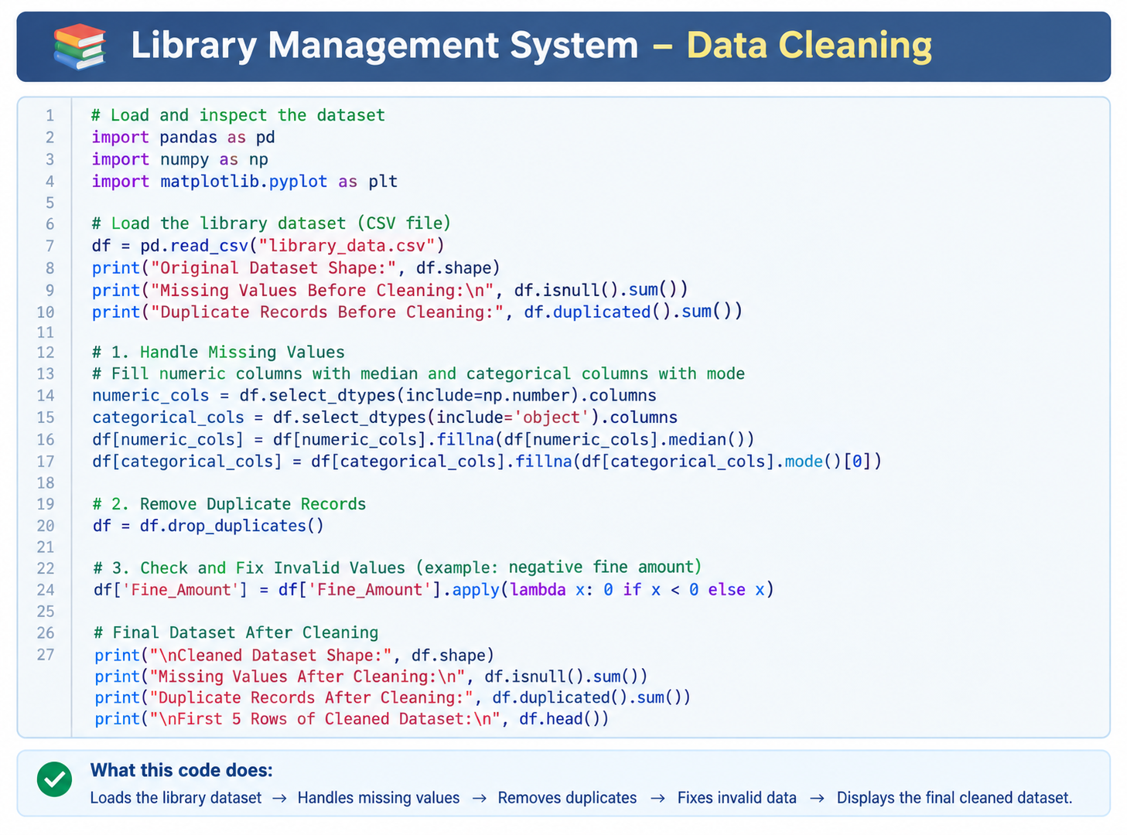
DATASET SNAPSHOT — LIBRARY RECORDS
The dataset is created inside the Colab notebook, exported as library_data.csv, then read again for analysis.
Check | Before | After
Rows | 69 | 55
Columns | 13 | 10
Missing values | 3 | 0
Duplicate rows | 11 | 0
Target distribution | 434 approved | 180 not approved

Slide 5
IMPLEMENTATION — GOOGLE COLAB WORKFLOW
The notebook uses a clear sequence: create data → save CSV → read CSV → inspect → analyze → visualize → recommend.
1
Create DataFrame
Dictionary data is converted into a Pandas DataFrame.
2
Save as CSV
df.to_csv("library_data.csv", index=False) stores the dataset.
3
Read CSV
pd.read_csv() reloads the file for analysis.
4
Inspect Data
shape, columns, dtypes and isnull().sum() verify quality.
5
Analyze
NumPy and Pandas calculate statistics and category/status counts.
6
Visualize
Matplotlib displays four labelled charts.
7
Recommend
Filters books using popularity and available-copy conditions.
5

Slide 6
NUMPY & PANDAS ANALYSIS — KEY RESULTS
Borrow count and fine amount are selected as numerical fields for summary statistics.
12.4
20
7
11.5
Average borrow count
Maximum borrow count
Minimum borrow count
Median borrow count
4.03
₹19.0
₹60
7 / 3
Standard deviation
Average fine amount
Maximum fine
Books issued / available
Interpretation
Borrowing ranges from 7 to 20 times. The average of 12.4 shows moderate overall demand, while the spread indicates that some titles are noticeably more popular than others. Fine amounts range from ₹0 to ₹60.
6

Slide 7
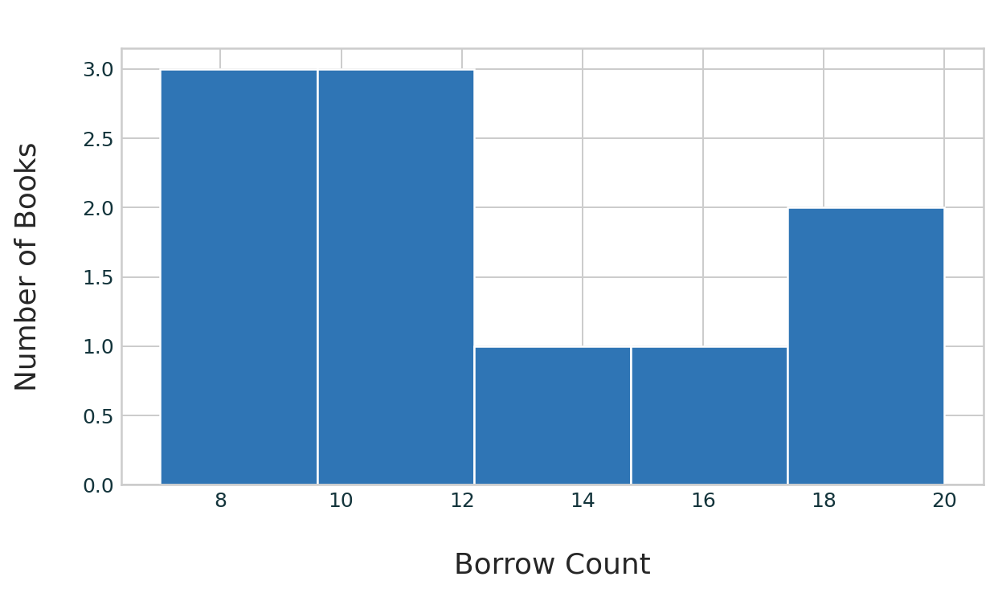
VISUALIZATION — BORROWING DISTRIBUTION
Histogram groups books by their borrowing counts and makes demand variation easy to see.
What it shows
Most books fall between roughly 7 and 15 borrowings; a few titles have higher demand.
Why it matters
Library staff can identify frequently borrowed titles and plan future purchases.
High-demand examples: Artificial Intelligence (20), Machine Learning (18), and Python Basics (15).
7

Slide 8
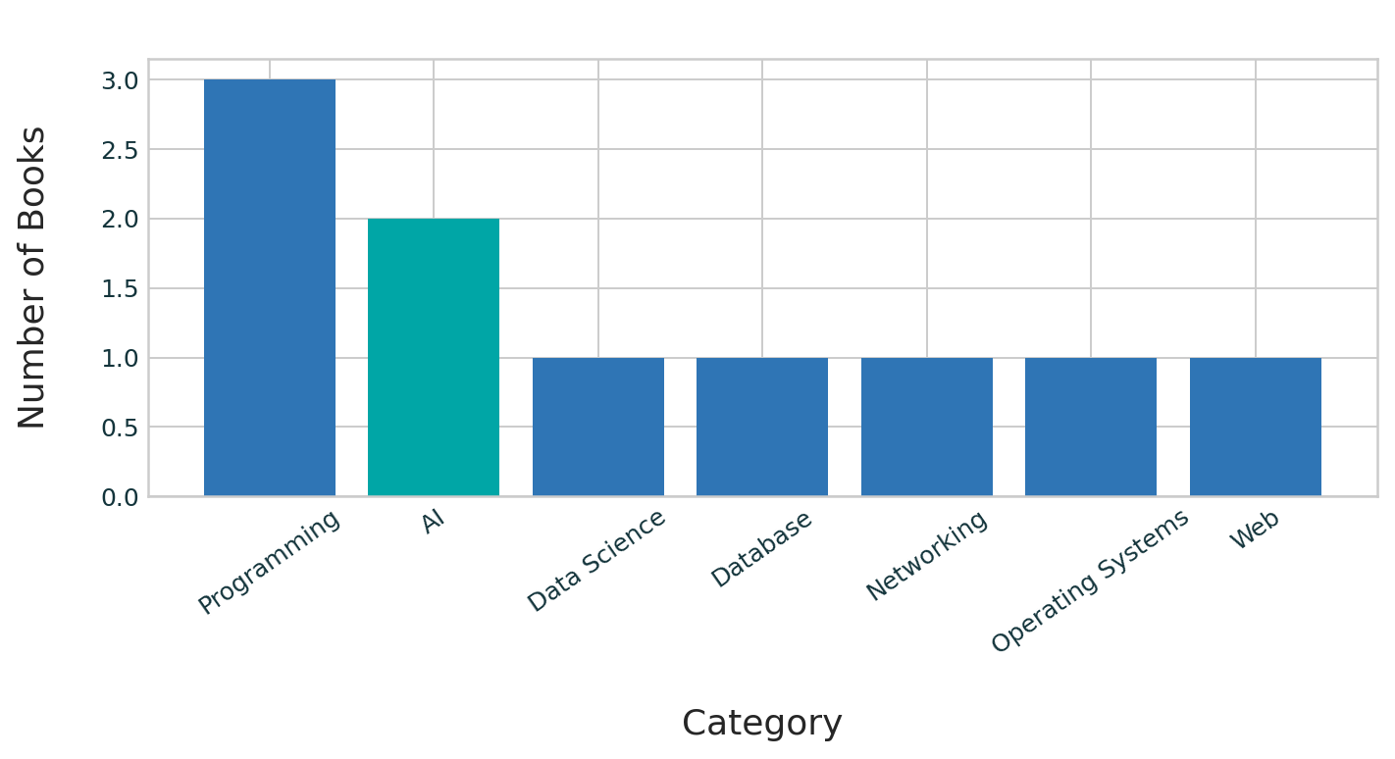
VISUALIZATION — CATEGORY ANALYSIS
The bar chart counts how many books belong to each category in the library sample.
Key finding
Programming is the largest category with 3 books. AI is next with 2 books.
Interpretation
The collection has stronger coverage in Programming and AI, while several other categories have only one book.
8

Slide 9
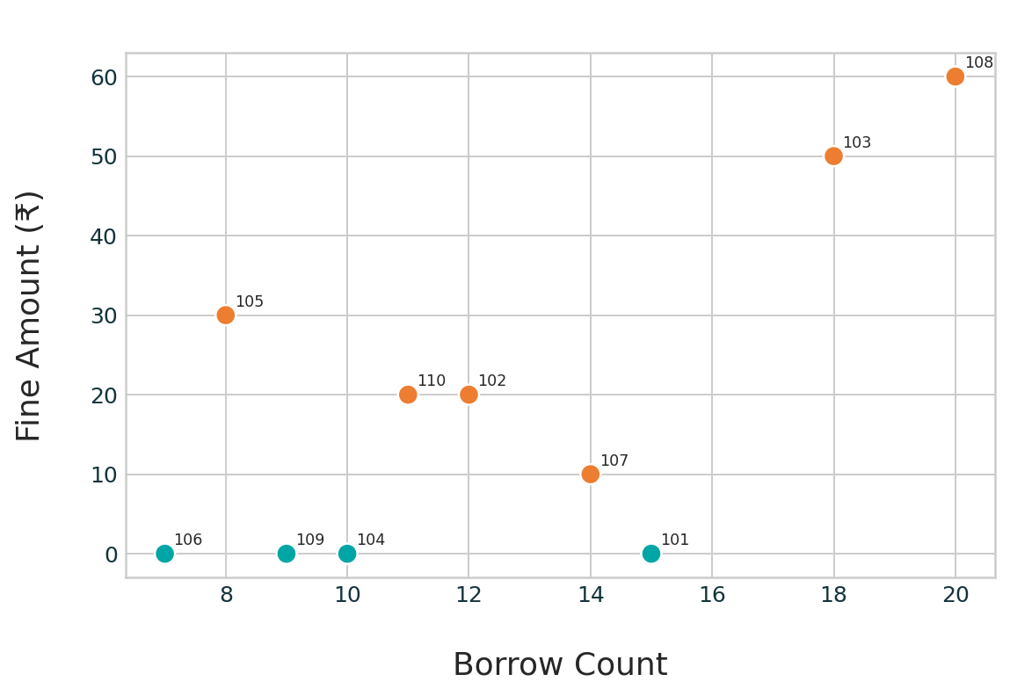
VISUALIZATION — BORROW COUNT VS FINE
The scatter plot compares each book’s borrowing demand with its fine amount. Labels show Book_ID.
Observation
Artificial Intelligence (Book_ID 108) has the highest borrow count, 20, and the highest fine, ₹60.
Observation
Machine Learning is also highly borrowed (18) and has a ₹50 fine.
Meaning
High fine and high borrowing can indicate heavily used titles that need circulation monitoring.
9

Slide 10
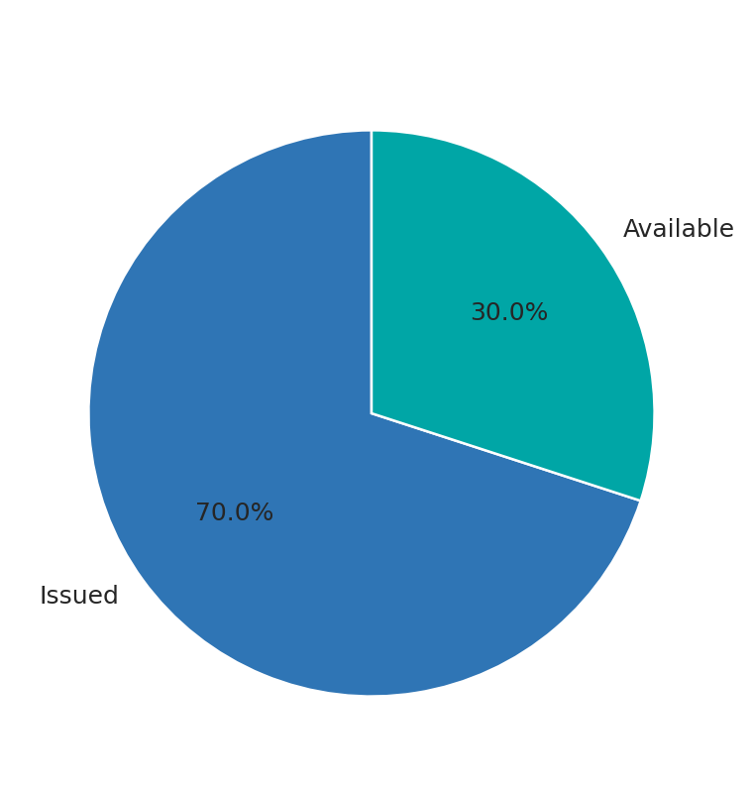
VISUALIZATION — BOOK AVAILABILITY STATUS
The pie chart summarizes the current status field for all 10 books.
70%
Issued books
7 out of 10 records
30%
Available books
3 out of 10 records
Important: A title can be marked “Issued” while still having Available_Copies > 0, because some copies may remain on the shelf.
10

Slide 11
BOOK RECOMMENDATION — IMPROVED LOGIC
Rather than only testing two user-entered numbers, the improved code filters and displays real books from the dataset.
minimum_borrow = int(input("Enter minimum Borrow Count: "))
recommended_books = df[
(df["Borrow_Count"] >= minimum_borrow) &
(df["Available_Copies"] > 0)
]
print(recommended_books[["Book_Title", "Borrow_Count",
"Available_Copies"]])
Rule
A recommended title must meet the chosen minimum borrow count and have at least one copy available.
Example input
Minimum Borrow Count = 15
Expected books
Python Basics; Machine Learning; Artificial Intelligence.
This makes the final output practical because it names the books that satisfy the condition.
11

Slide 12
RESULTS & KEY INSIGHTS
The project produces completed evidence from data creation through final recommendation.
Most Borrowed Book
Largest Book Category
Artificial Intelligence is the most borrowed title with 20 borrowings.
Programming has the largest category count: 3 books.
Book Availability
Fine Analysis
7 records are marked Issued and 3 are marked Available.
Fine amounts range from ₹0 to ₹60; the mean fine is ₹19.
Recommendations
Popular titles can be automatically filtered using Borrow_Count and Available_Copies.
Outcome
A beginner-friendly library analytics workflow that combines data storage, statistical analysis, visualization and a basic recommendation feature.
12

Slide 13
COMPLETED PROJECT WORKFLOW
Every stage has proof in Google Colab: code cells, printed output, a CSV file or a visualization.
Dataset
Creation
→
CSV
Storage
→
Data
Inspection
→
NumPy / Pandas
Analysis
→
Charts &
Interpretation
→
Recommendation
Output
Evidence demonstrated
• DataFrame and CSV creation
• Dataset information and null-value checks
• Statistical output using NumPy and Pandas
• Four labelled visualizations
• Recommendation filtering based on conditions
13

Slide 14
CONCLUSION — SECOND REVIEW
The Library Book Borrowing Analysis and Recommendation System demonstrates a complete mini data-analysis project in Google Colab.
• A structured dataset of 10 library books was created and saved as a CSV file.
• Pandas inspection confirmed 8 columns and no missing values in the sample dataset.
• NumPy and Pandas produced useful borrowing and fine statistics.
• Four visualizations explained demand, category coverage, fine patterns and status distribution.
• The improved recommendation logic identifies popular books that still have available copies.
Review-2 Focus: Demonstrate completed code, meaningful outputs, visual interpretation and project learning.
15

Slide 15
THANK YOU
Questions & Viva
Library Book Borrowing Analysis and Recommendation System
16

